Slide 1
ENERGY CONSUMPTION
ANALYSIS
Energynomics. Inc.

Slide 2
Introduction
The overarching goal is to understand the driving factors behind energy consumption in the counties of South Carolina and North Carolina through July. This involves through EDA and modeling to discover impactful explanatory factors.
This approach helps simulate energy consumption and future requirements and seeks to mitigate the need for additional energy production facilities and contribute to a cost-effective and preventative approach to energy saving.

Slide 3
Overview
This project mainly focused on the impact of energy consumption with an increase in temperature and how it varies with variables of interest.
Data Cleaning and EDA
Feature Engineering and Modeling
Prediction and impact analysis

Slide 4
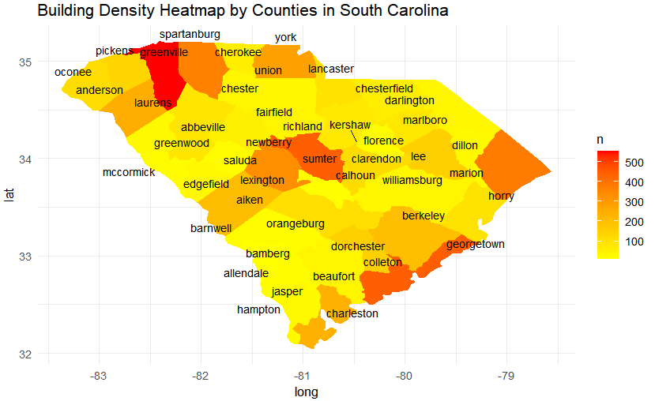
Data Cleaning and EDA
We started by removing any nulls in the data and checked for percentages of blanks.
Since we started with around 170 variables we removed any variables that had only one unique value in it and proceeded to create a heat map to understand the significance of the region.
Notes:
To clean the data we looked for any Na or null values and removed them. We also checked the percentages of blanks and found that there weren’t many such rows. We also got rid of any coloumns that had only 1 value in the column as it would not be helpful of the analysis.
We saw that county wise there was a variation in energy consumption, which meant that segregating the data atleast by county was imperative, if not by building ids, we would have to do further analysis to know more. We looked at some of the more obvious graphs in the next slide

Slide 5
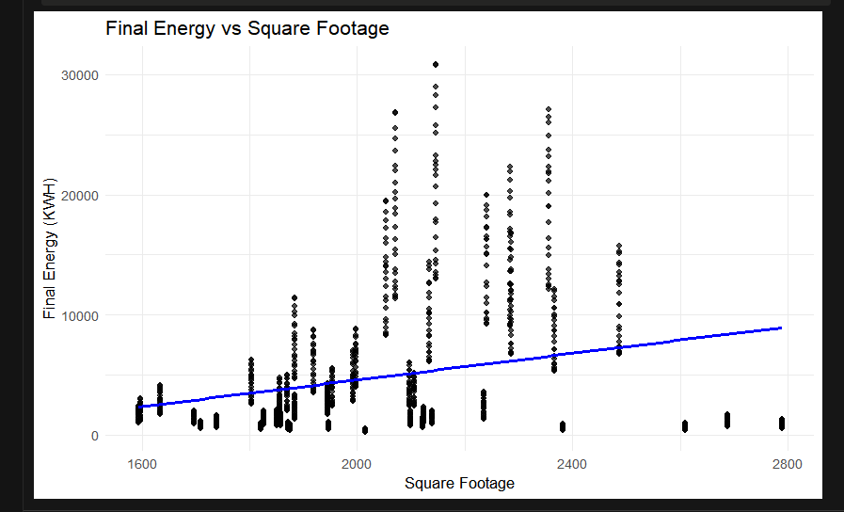
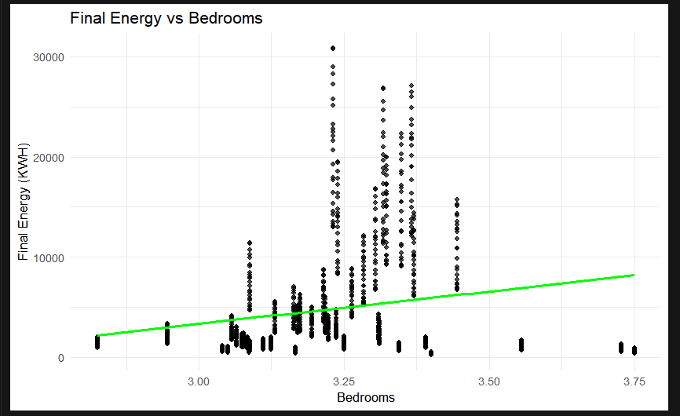
Some prominent explanatory variables
Notes:
Here we see a positive correlation between sqft and bedrroms with energy consumption as one would expect

Slide 6
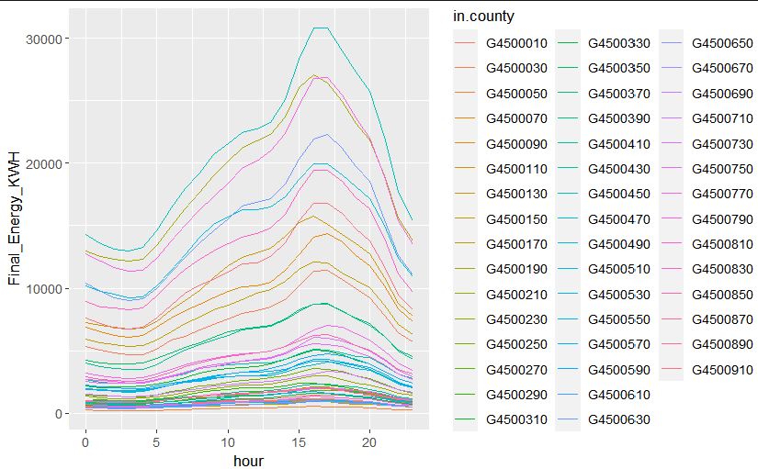
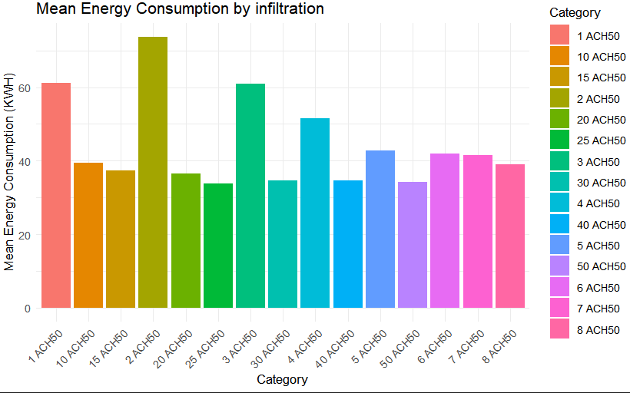
Feature Engineering and Modeling

Slide 7
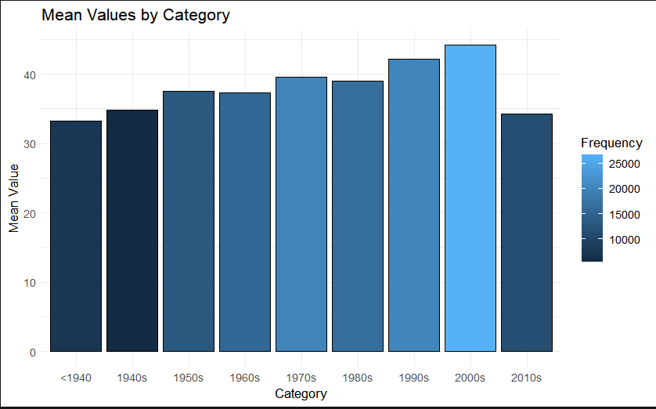
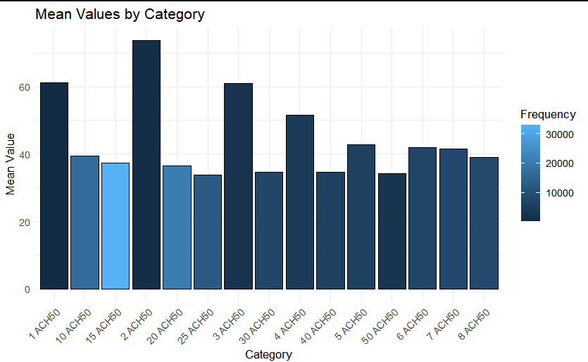
Feature Engineering and Modeling
For example, we saw a direct relation between temperature and ACH. This was a significant relationship as the type of infiltration caused a great impact on energy consumtion
Here we see over time energy consumption doesn’t necessarily increase

Slide 8
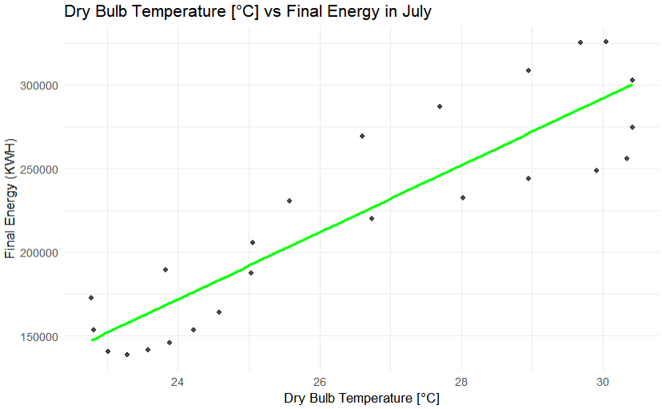
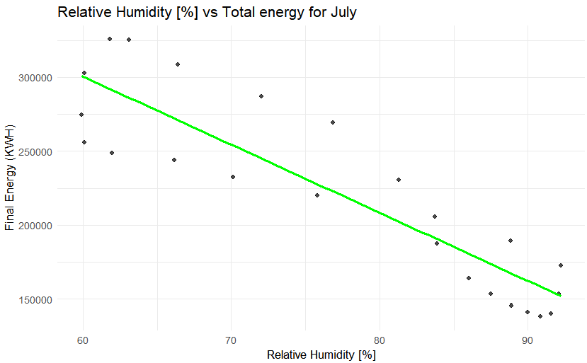
Weather Data vs Total Energy Consumption for July
Most of the factors in the weather data had a positive correlation with the total energy.
Relative humidity had an inverse relation as shown below.
The above graph shows a scatter plot with a lm line fitted into it showcasing a linear positive correlation between the energy and temperature.
The same follows with global, direct and diffuse ration as well.

Slide 9
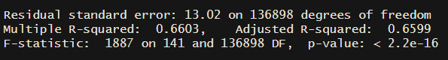
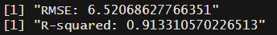
Model Output
Linear Regression Summary
XGBOOST Summary
It helps mitigate the problem of overfitting - because of its inbuilt regularisation techniques - considering the number of variables and the number of factors we have in the model
This was one of the most important reasons for us to choose xGBoost- xGBoost can handle non-linear relationships between the predictor and the target variables.
Adjusted R-squared adjusts for the number of predictors to provide a more accurate indication of the model's goodness of fit. In this case, the adjusted R-squared is 0.6599
Along with this, we did some cross-validation to conclude that the model would be overfitting on adding any more features and moved to a different approach.
Notes:
- Less sensitive to outliers - with the presence of airbases, airports and such buildings in the data - we had to be keep this in mind while choosing the model- It is a predictive model rather than an inferential model - more useful to make predictions - considering the demands of this project.- XGBoost provides feature importance scores, allowing you to understand which variables have the most significant impact on the prediction. This can help you identify key drivers of Final Energy Consumption.

Slide 10
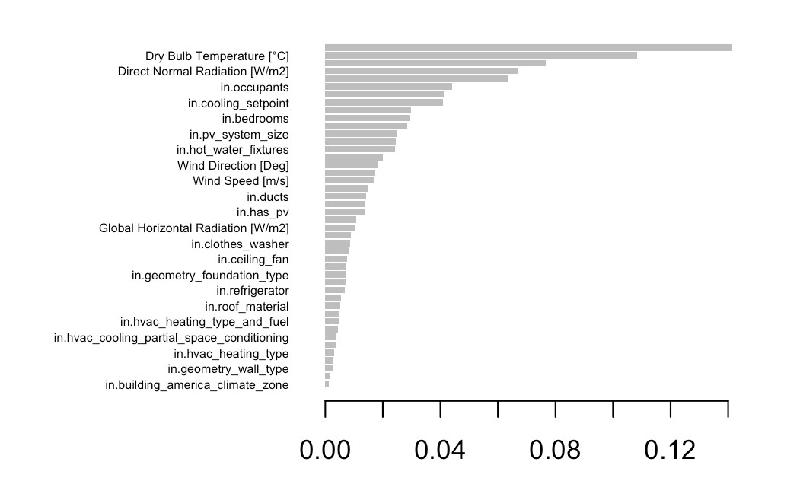
Finding from the final model
The factors at the top of the importance matrix ie Dry Bulb Temperature, Direct Normal Radiation, Number of Occupants are the most significant drivers of the xGBoost model.

Slide 11
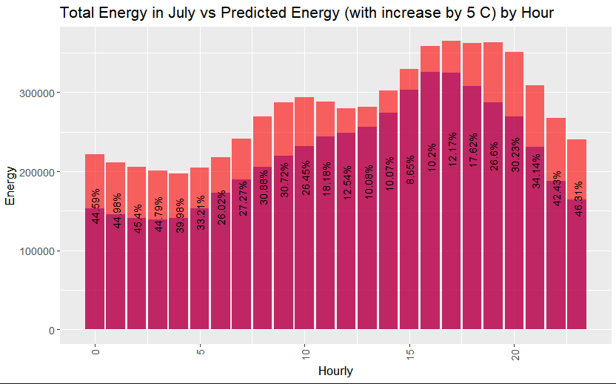
Impact of a 5 Degree Increase in Temperature

Slide 12
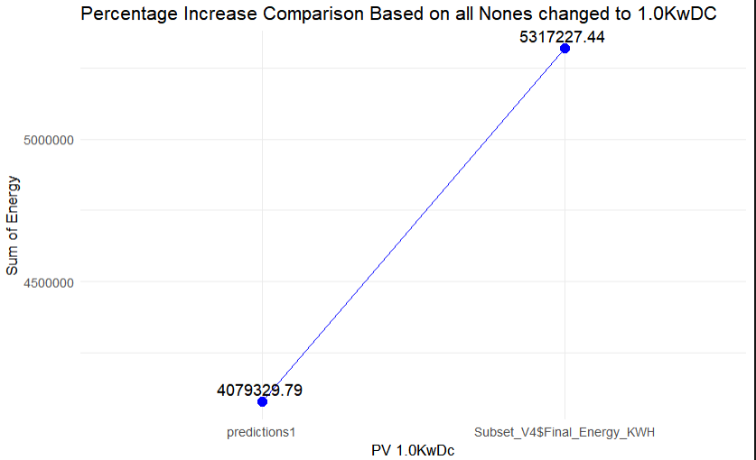
How to Reduce Energy Consumption?
We simulated the expected energy for various features that were significant to our model to reduce energy consumption.
Out of those, with a reduction in leakage in ducts there was a small decrease of 10%
The most prominent one was photovoltaic solar panels. On adding a small-sized panel to buildings that have none there was a significant decrease as seen in the graph.(5.3 Million to 4.1 Million)
Notes:
If you switch all the none pv ducts to 1.0kwdc the 5.3 to 4.1
Ducts dcreaece is to a slightly less degree on its ow 5.3 to just 5.2

Slide 13
Thank you
Janelle Bauske
Mansi Gopani
Keerthi Krishna Aiyappan
Nagul Pandian Chinnasamy Ramkumar
Nandita Ghildyal

